Slide 1
Workbook Sales & Gross Profit (Historical)
Internal Use Only
April 2017
EXCEL FILE:

Slide 2
Disclaimer
The content of this workbook has been produced by KPMG Germany/Deal Advisory on the basis of German accounting standards and/or IFRS, as well as considering KPMG Germany’s firm and country requirements, regulations, processes, policies and best practices. Please check your local accounting and other requirements before applying the content.

Slide 3
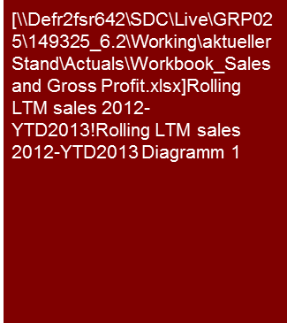
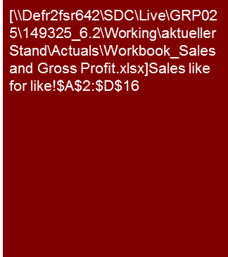
Overview (1/3)
Sales & Gross Profit (historical)
Benchmarking Plus tool and Sector User Guides are available in Germany. Please ask for benchmarking options in your region.
Mission Statement:
The analysis of sales and gross profit is generally key to understand the business model. The value drivers and trends identified form the basis for evaluating the Business Plan.
Customer situation
Definition/Methodology/Tools of the basis analysis
Buy Side/Sell Side/JV/Turnaround
The primary objective of the sales and gross margin analyses is to identify the profit generating products, customers and regions and to form an understanding of the business model
To understand the drivers of growth external trends (country and sector economics, competition, regulatory environment, etc.) and the impact of internal measures (new products, strategic reorientation, restructuring, etc.) have to be determined.
The sales and gross margin analyses form the basis for the subsequent Business Plan analysis and valuation model assessment.
Trend analysis – Rolling LTM sales, 2012 – YTD13
Material principles
The level of detail of the analyses depends on the scope of work and the available information (align structure with commercial DD and Business Plan analyses), e.g.:
Group, sub-group, legal entity; and/or
Segment, region, product group, product, customer.
Sources of information
Sales controlling and contribution margin analyses;
Annual report / segment reporting (reconciliation internal/management reporting to external/audited financial statements may be required).
Potential issues for sales analyses (trends and drivers):
Product mix and price/volume analyses;
Sector specific KPIs (e.g. sales per sqm in retail);
Product lifecycles and seasonality;
Like-for-like analysis, customer/contract churn, and/or opportunities or risks from major customer wins/losses.
Margin analysis (trends and drivers):
Price/volume analyses for major cost line items;
Commodity and currency hedging;
Supplier dependency;
Fixed costs ratio and operational gearing.
When available information is limited or insufficient, qualitative statements are still preferable to no margin analysis at all.
FY13 full year forecast amount.
Degree of Standardization
Sales and (gross) margin analyses depend highly on the respective sector specific requirements and the available management reporting. The potential for standardization is limited to an Excel Toolbox with examples for analyses and graphic illustrations of the results.
Sector user guides and Benchmarking Plus tool are helpful to identify sector specific KPIs.

Slide 4
Overview (2/3) – Total cost method (TCM) analysis structure and resulting workbooks
Sales & Gross Profit (historical)
Flag: Total Cost Method is commonly used in the DACH region. Check your local GAAP requirements before applying TCM in your analysis.
High level P&L analysis
Workbooks for detailed analyses – Value Driver Tree
Commentary
Explanation of key trends (sales growth, profitability in % of sales, significant shifts in individual P&L lines), if necessary supplemented by individual operational KPIs and/or benchmarks; depends strongly on business model and sector of the specific company
Purpose of high level P&L analysis:
Planning of our work: determine key areas of focus for detailed analyses
Reporting: Provide a Big Picture Overview on Target's financial performance and a summary of key trends observed
Workbook ”Sales and Gross Profit"
The detailed analyses should
improve our understanding of the business model
show trends in financial performance (monthly or quarterly as appropriate)
identify sales and profit drivers by an appropriately detailed analysis (by product group, customer, etc.) and provide respective benchmarking
form the basis for the Business Plan / analysis of projections (→ starting point for financial model)
Market development
Sales
x
Price
Gross Profit
Trend analysis (with KPIs)
Volume
-
Differentiated according to product groups, customers, regions (as applicable)
Margin (in % of sales)
Costs of materials
Price
By type of materials
x
EBIT
Volume
-
Workbook “Expenses Total Cost Method"
Personnel costs
Headcount (FTEs)
Differentiated according to functions (production/storage, R&D, sales, administration)
x
Level of remuneration
Expense items below gross profit
Analysis aims at making cost structure and drivers transparent
Other expenses (+ earnings)
Trend analysis by type of expense
e.g. yoy growth, in % of sales, per sqm rental space, etc.
Fixed vs. variable and cost drivers
Workbook “Investments"
Trend in relation to CAPEX
Impairments
Useful life and if necessary changes in accounting principles
Depreciation
Workbook "Normalized Earnings"
The goal is to understand the underlying profitability
Adjustment of the historical earnings for "one-off effects" that are not relevant for the future development.
One-off effects

Slide 5
Overview (3/3) – Cost of sales analysis structure and resulting workbooks
Sales & Gross Profit (historical)
High level P&L analysis
Workbooks for detailed analyses – Value Driver Tree
Commentary
Explanation of key trends (sales growth, profitability in % of sales, significant shifts in individual P&L lines), if necessary supplemented by individual operational KPIs and/or benchmarks; depends strongly on business model and sector of the specific company
Purpose of high level P&L analysis:
Planning of our work: determine key areas of focus for detailed analyses
Reporting: Provide a Big Picture Overview on Target's financial performance and a summary of key trends observed
Workbook ”Sales and Gross Profit"
The detailed analyses should
improve our understanding of the business model
show trends in financial performance (monthly or quarterly as appropriate)
identify sales and profit drivers by an appropriately detailed analysis (by product group, customer, etc.) and provide respective benchmarking
form the basis for the Business Plan / analysis of projections (→ starting point for financial model)
Market development
Sales
x
Price
Gross Profit
Trend analysis (with KPIs)
Volume
-
Differentiated by product groups, customers, regions (as applicable)
Margin (in % of sales)
Costs of sales
Price
By type of materials
x
EBIT
Volume
-
Workbook “Expenses Cost of Sales Method"
Sales and distribution costs
Analysis of personnel costs in the individual P&L blocks:
See personnel cost analysis in the total cost format workbook, (FTEs and personnel costs per FTE), however, personnel costs are not recorded within one P&L line but spread across the various cost categories
Each trend analysis must be tailored to the (sub) type of costs
Expense items below gross profit
Administrative costs
Analysis should make cost structure and drivers transparent
The challenge is often the level of details available for the various cost types (e.g. breakdowns may not be available). However, it may be possible to analyze the costs on a cost center level.
Analysis of the cost structure (fixed vs. variable), benchmarking, cost driver
Other expenditures (e.g. R&D)
Workbook “Fixed assets – CAPEX"
Trend in relation to CAPEX
Impairments
Useful life and if necessary modifications of the balance sheet
Depreciation
Workbook “Normalized Earnings"
The goal is to understand the underlying profitability
Adjustment of the historical earnings for "one-off effects" that are not relevant for the future development.
One-off effects

Slide 6
Pitfalls and lessons learned
Sales & Gross Profit (historical)
No. | Specific analysis
 | Lack of focus on value drivers: E.g. for an oil trader don't focus on sales growth in EUR or USD, but on volume (in tons or barrels) and profit per ton or barrel; for an aircraft manufacturer the order book (volume and pricing) should receive more attention than historic sales and margins for models to be replaced in a few years; sales price/volume analysis will remain meaningless when we do not understand what is driving the respective volumes and prices; etc..
 | Inconsistencies compared to the Business Plan: We frequently analyze historic performance before the Business Plan, partly because the Business Plan often has yet to be finalized when we start work, but also because it is easier to analyze a Business Plan once you have understood the historical financial performance of a Company. This can become a problem when we learn only late in the process, that the Business Plan follows a different format/structure than the historic financial reporting, e.g. historic reporting was analyzed based on audited external reporting in a total cost format; whereas the Business Plan follows a contribution margin format; or sales planning for the Business Plan is by customer, but historic sales reporting was by product, etc. Therefore we should as early as possible map out the structure for both historical and Business Plan analysis, and check respective data availability. Furthermore a like for like comparison of past to projected performance may sometimes require pro-forma financial information to be prepared, e.g. when the target has recently acquired or disposed of a material part of its business (e.g. organic growth versus acquisition driven growth)
 | Missing (sufficient) detailed level of information on gross margin: Data availability regarding sales trends (by product, by customer, by region, etc.) is often better than regarding respective margin trends. If this is the case we need to discuss with management how gross margin trends can be analyzed and explained, and sometimes may need to revert to qualitative analysis, which is not backed by detailed quantitative analysis.
 | Lack of focus on current trading figures: Analysis of current trading information is often left until shortly before issuing a report, in order to use the most recent figures available. However, this leaves (too) little time to properly consider relevant findings in the Business Plan analysis. Furthermore the granularity of current trading data often falls short of the level of detail for historical analyses. In order to still gain as much as possible insights from current trading performance it is important to choose the right type(s) of analysis; e.g. comparison of YTD figures to budget and previous year, gap analysis of what needs to be achieved 'year to go' in order to achieve the full year budget, monthly (or moving average) sales and margin trend analysis, etc.; and so it may be wise to run a test analysis e.g. on August YTD even if we expect that September numbers will be available before we finish our work/report.
 | Unsuitable benchmarks: The comparison of gross margins for two companies is often difficult, especially when compared in the cost of sales format. Typical challenges include inconsistent cost allocation, varying product and price structures, and distinct cost structures.
1
2
3
4
5

Slide 7
Core issue (1/3)
Sales & Gross Profit (historical)
Core Issue | Specific analysis | Page(s)
What are the major drivers for the sales development compared to the macroeconomic development and how can such trends be reflected in the business plan (see planning workbook) ? | High level trend analysis of sales and gross margin (in %). Analysis of year-on-year growth rates. Search for meaningful high-level KPIs (e.g. year on year sales growth rates or gross margin in % of sales) and respective benchmarks. Presentation of key changes by means of sales bridges. | 10,20
2. Analysis by segments (products, customers, regions, etc.)? How does the company monitor, control and plan the business and based on which data basis? What are relevant drivers for the sales development of each segment? Which are the most important segments to focus on (in particular with regard to the Business Plan Analysis)? | Evaluation of sales share per segment (align structure with commercial DD and Business Plan analyses). Trend analysis of sales, gross margin and gross profit per segment. Comparison of sales development with relevant market trends. Search for sector-specific KPIs (e.g. revenue per bed/room for hotels, seat load factor and yield for airlines). | 12-14, 16/17
Were sales and margins impacted by extraordinary events and how are these reflected in the business plan ? One-offs, e.g. large non-recurring projects, changes in accounting principles, window dressing and channel stuffing. Management measures such as price increases or advertising campaigns. Structural changes such as new products/customers/regions, changes in the consolidation perimeter, insolvency of competitors, etc. | Evaluation of trends and explanation of outliers (appropriate periods, the shorter the more precise). Price / volume analysis (to quantify impacts, e.g. from successful sales price increases, rebates from major suppliers, external effects such as air traffic tax on airline tickets, etc.). Critical review of verbal explanations on monthly reporting. Combine findings from various analyses, e.g. effects from international expansion on profitability and distribution costs. Foreign sales: Analysis of trends in local currency. Like-for-like analysis to show comparable pro-forma figures as if a 'structural change' (e.g. customer loss) had happened prior to the period under review, or existing versus new business from major new product launches) | 11,12,19
4. Seasonality and volatility of the sales development during the year? Do well-defined (and thus predictable) seasonality patterns exist? Do monthly sales fluctuate significantly and if so, why? How would sales adjusted for seasonality and volatility develop? | (Monthly) Trend analysis and seasonality graphs. Volatility: Form a view on the accuracy of monthly cut-off procedures and consider quarterly or LTM (rather than monthly) trend analysis. Underlying trend analysis: Moving average (e.g. LTM = last twelve months) or growth rates compared to the same period of the previous year. Analysis of headcount, use of temporary workers etc. | 15,16

Slide 8
Core issue (2/3)
Sales & Gross Profit (historical)
Core Issue | Specific analysis | Page(s)
Does a dependency on major customers exist; what is the risk of losing customers (stand alone and with respect to a sale of the company)? | TOP 10 customer analysis. Churn rate analysis, i.e. share of customers lost or won each year. Ratio of recurring to one-off orders. Presentation of transaction relevant “change of control“ clauses. | 13
Order intake and backlog What is the level of "forward visibility" of sales and gross profit? Which trends in order intake and backlog are visible How precise is the separation of backlog (fixed contracts) to pipeline (weighted applying probabilities); what does the pipeline’s develop look like? | Explanation of the average duration of projects (and "waterfall" , i.e. when does backlog generate sales). Monthly development of "book to bill ratio” (order intake versus sales) and of order backlog. Composition of order backlog (e.g. TOP 10 and other projects) as per the last effective date (sales and expected margin). Composition of the pipeline. | 23
How did gross profit develop historically and (how) could such trends proceed in the Business Plan (see Planning Workbook)? | Analysis analogous to sales, additional consideration of : Mix effects (relative percentage of high and low margin products, customers, regions, etc.); Price trends in procurement; Operational gearing (fixed cost degression); Structural changes to the cost base; e.g. make or buy decisions, restructuring projects, moving production to low cost countries, etc. Impact of changes in inventory (and corresponding valuation of finished/unfinished goods) on the margin. Presentation of main effects using a gross profit bridge. | 11,12, 14-18
Cost items of COGS (CoS) or costs of materials (TCM) What are key costs of sales/of materials, cost drivers and the corresponding trends? Does the company rely on several suppliers for important raw materials and components? What is the share of fixed costs (CoS) and how has this been reflected into the Business Plan? | Categorization of COGS or costs of materials according to types of costs. Price / Volume analysis for major material cost items. TOP10 suppliers. COGS: Presentation (if applicable, qualitative) of direct personnel costs and corresponding cost drivers (costs per employee as well as extent and reason for deviations from standard costs). | 24, 25

Slide 9
Core issue (3/3)
Sales & Gross Profit (historical)
Core Issue | Specific analysis | Page(s)
Price and currency risks How significant are the risks and how are these managed? Are there natural hedges or price escalation clauses? Does the company use hedging proactively, how has this impacted historical trading and which safeguards are implemented? | Presentation of major currency and price trends; impact on sales and margin development. Comparison of sales and costs per currency; comments on currency exposure and effectiveness of natural hedges. Evaluation of customer and supplier contracts with regard to price escalation clauses. Presentation of the hedging strategy and its reflection in the balance sheet. | n.a. (best practice examples welcome)
How does YTD trading compare to budget/previous year? What implications does this have for the Business Plan (see Planning workbook)? | Comparison of current trading to budget and YTD of previous year. Gap analysis ('year to go') compared to year to date and to prior year figures (e.g. % of budgeted full year sales achieved to date compared to the same figure as of last year; margin (in % of sales) to be achieved in order to make full year budget compared to YTD margin achieved); LTM analysis. Rolling forecast | 20-22
Assessment of the cost structure compared to competitors; to what extent does potential for cost-cutting exist? | Benchmarking of unit costs (pay attention to comparability, e.g. total cost method to COGS margins, full absorption costing versus direct costs / contribution margins, etc.). | n.a. (best practice examples welcome)
Related party transactions (carve out situations) To what degree is the company integrated in the group-internal supply chain and what might change going forward? How is the transfer pricing performed and (how) will this change in the future? How will corresponding “stand alone” changes impact on the working capital? | Presentation of major value streams with other group companies. Description of the transfer price system. Comment on changes in transfer prices in the past and expected effects going forward. Explanation regarding historical and expected working capital effects. | 26
Have capacity bottlenecks been detected during sales peaks; are “bottlenecks” or investment requirements visible in the Business Plan? | Description of capacities (important machines, storage capacity, headcount and shift system, access to temporary workers, etc.). Analysis of the capacity utilization and the potential for capacity adjustments (e.g. introduction of additional shifts, outsourcing, etc.). | n.a. (best practice examples welcome)

Slide 10
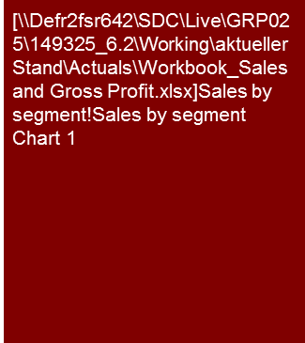
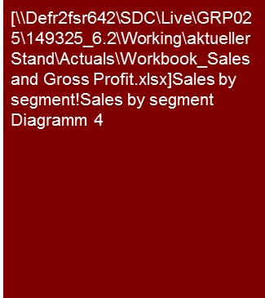
Sample analysis – Sales by segment
Sales & Gross Profit (historical)
Sales increased by a CAGR of 5.2% from 2010 to 2012 driven by a rise in demand for non-welded pipe solutions in the Norwegian off-shore market.
Company business is dominated by sales to the offshore market which accounted for 75% of total sales in 2012.
The majority of sales are of individual products (79% in 2012) although the company also carries out long term projects and provides after sales service.
Annual segment sales development and sales growth
Note: Sales include inter company unless otherwise stated
Sources: VDD report; Monthly management accounts; Management information; KPMG analysis
Annual sales^{(a)} split by segment and type of business 2012
Land based
Service
Marine
Projects
Offshore
Products
Note: (a) Sales exclude €1.3m inter company sales
Source: management information

Slide 11
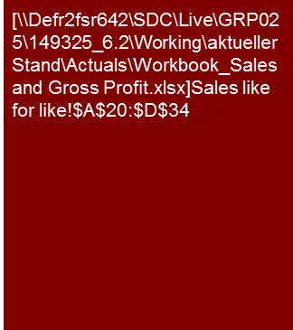
Sample analysis – Like for like sales overview
Sales & Gross Profit (historical)
Overall, like for like sales decreased by a negative CAGR of 4.0% from FY2010 to FY2012 whereas gross margin increased slightly from 44.5% to 44.9%
Like for like sales exclude the sales of all stores closed or planned to be closed over the period from FY2010 to FY2015 and an adjustment to sales to reflect the transfer of business in certain stores to Company X. Like for like sales have not been adjusted for stores undergoing major refurbishment, store relocations or the introduction of concessions other than Company X.
Like for like gross margin 1 excludes inventory differences (shrinkage), inventory provision movements and wrapping material.
Like for like sales and gross margin 1 are analyzed by category on the following slides.
Source: Management information
Note: (a) Please refer to the Appendix for a reconciliation in full detail
Source: Management information

Slide 12
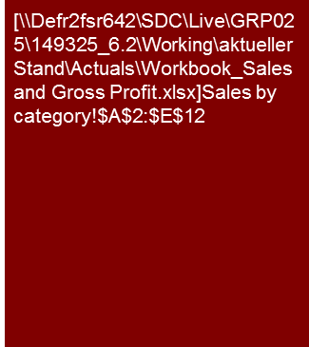
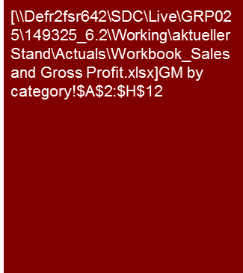
Sample analysis – Like for like sales by product group
Sales & Gross Profit (historical)
Variances between product categories are significant with Fashion and Sports declining by approximately 2% compared to 14% for Multimedia.
This partly reflects a reallocation of floor space from Multimedia to Fashion.
Retail gross margin 1 increased to 44.9% in FY2012, partly due to changes in product mix (less Multimedia) and efficiency initiatives.
Like for like retail sales by category
Sales in FY2010 (which incorporates the last quarter of the calendar year 2009) benefited from the Company year jubilee. In FY2012, insolvency accelerated the sales decline from May onwards. Like for like sales declined by only 1.6% in the seven months ended 30 April 2012 compared to the same period of the prior year. Management estimates the negative impact of insolvency on sales at €97 million in FY2012 (2.7%). Both factors limit a year on year comparison.
Part of the decrease in like for like retail sales over the historic period is attributed by management to a sub-optimal capex allocation resulting from concentrating capital expenditure in the premium stores and a small number other selected stores.
The above average decline in Multimedia sales results from particularly strong competition in this category, its strong sensitivity to the insolvency and a shift in floor space away from Multimedia to Fashion.
Like for like gross margin 1 by category
Gross margin 1 decreased in FY2011 due to mark-downs in connection with category management measures.
The increase in gross margin 1 in FY2012 largely reflects floor space reallocation and the disproportionate decrease in Multimedia sales on account of insolvency. Mark-downs on account of category management measures continued to be significant.
Source: Management information
Source: Management information

Slide 13
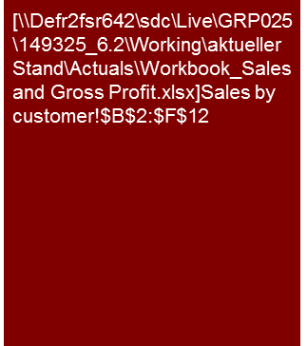
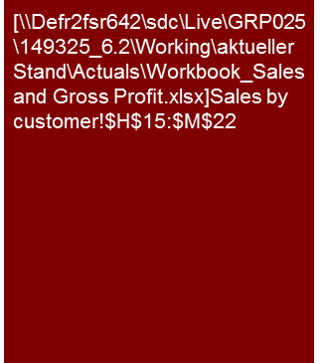
Sample analysis – Sales by customer
Sales & Gross Profit (historical)
In 2011, 49.1% of Target Germany sales were generated from its main customer ‘Customer A’. Target Germany and Customer A recently signed an agreement that, according to management, guarantees price increases until the end of 2014.
Customer B and Customer C are further key customers of Target Germany accounting for 24.1% of total sales in 2011. Management states that both companies are long-term customers of Target.
Management has been able to negotiate price increases in 2011/12 after having to agree to price cuts in lots of cases during the financial crisis.
Customer A
Customer A is the largest customer of Target Germany accounting for almost 50% of Target Germany’s total sales in 2011. Management states that Target Germany currently has a framework contract with Customer A that includes a three-year agreement on prices of products in 2011. The agreement expires at the end of 2014.
While prices decreased by 2.5% in 2010 and 2011, a price increase has been negotiated in the new agreement, leading to a positive price effect of approx. €525,000 in 2012, €200,000 in 2013 and €100,000 in 2014.
Customer B
Sales to Customer B increased in 2011 due to higher sales volumes from a particular plate. Management expects sales to decrease in 2012 as Target will stop supplying this product to Customer B as the margin is low and Customer B did not agree to a price increase.
Customer C
Customer C is one of the main customers within the product group and increased its sourcing from Target within recent years. Customer C agreed to price increases for all products of 6.5% in March 2011 and further 6.5% starting from March 2012.
Customer D
Customer D is the fourth largest customer of Target Germany and primarily sources machinery products. Target has negotiated price increases of 15% with Customer D, effective from October 2011 which management states it achieved due to its increasing cost base, higher procurement costs and lack of price adjustments in the past.
Source: Management accounts, Target Order development.xls, KPMG analysis
Note: The price increase with Customer A reflects the average increase spread over all product groups, while for other customers, the respective price increase is applied equally to the complete product offering.
Source: Management information, KPMG analysis

Slide 14
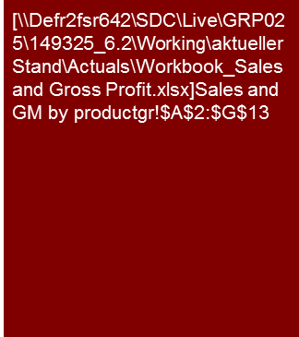
Sample analysis – Sales and gross margin by product group
Sales & Gross Profit (historical)
Segment Fault Location accounts for almost half of the group's sales.
Product groups Energy Tools and Leak Location have the highest gross margins followed by the largest product group Fault Location.
Fault Location
Gross margin for Fault Location products remained relatively stable, despite the large orders for CTVs in 2011 which had lower gross margins. The margin is also affected by whether the van itself is provided by the group or the customer. In particular for the two large orders in 2011, the vans were provided by the Group.
Testing and Diagnosis
Gross margin for Testing and Diagnosis products mainly varies depending on the product mix.
Cable and Pipe Detection
The fluctuation in gross margin over the period is mainly due to product mix and foreign currency effects.
Leak Location
Leak Location products generally have a higher gross margin than the other product groups as material costs are comparatively low and only very few OEM products are sold in this product range. On the other hand, R&D activities are comparatively high which is not reflected in the gross margin.
Gross margin in 2011 declined due to an increased share of large logger projects.
Note: (a) GM = Gross Margin
Source: Management information
Basis of preparation
The analysis is based on internal controlling reports, the structure of which is described in Appendix XX.

Slide 15
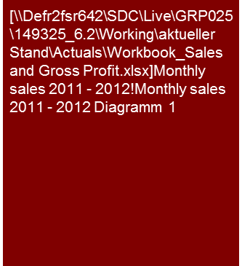
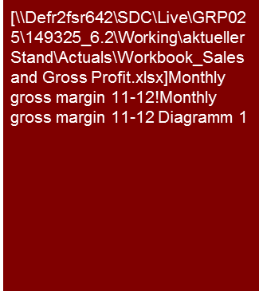
Sample analysis – Seasonal analysis
Sales & Gross Profit (historical)
Sales increased by 18% from 2011 to 2012, although monthly volatility increased.
The impact of holidays in April (Easter), July (Summer) and December (Christmas) can be seen in both years.
Gross margin remained relatively flat from 2011 to 2012 as a rise in steel prices (which could not be fully passed on to customers) was offset by cost saving initiatives in 2011 (full year effect) and 2012.
Monthly sales, 2011- 2012
∑= €41.8m
∑= €49.3m
Monthly gross margin, 2011 - 2012
∑= €16.3m
∑= €12.8m
Note: Sales include inter company unless otherwise stated
Sources: VDD report; Monthly management accounts; Management information; KPMG analysis

Slide 16
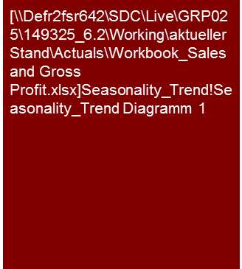
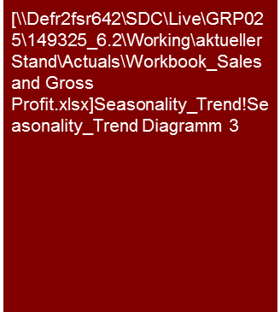
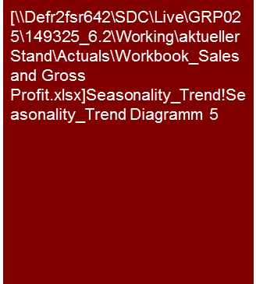
Sample analysis – Seasonal analysis
Sales & Gross Profit (historical)
ABC’s business is characterized by a very high degree of seasonality in respect of Christmas trading, and to a lesser extent Easter.
The seasonality of gross margins reflects particularly high mark-downs for end of season summer and winter sales.
XYZ sales seasonality
XYZ gross margin (% of sales) seasonality
Accumulative accounting adjustment (not phased)
Particularly high mark-downs in Fashion and Sports in FY2009 due to overstocking (impact is expected to reverse in FY2010).
Trend analysis 2007-2009

Slide 17
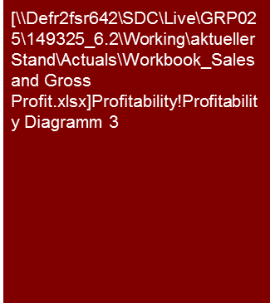

Sample analysis – Clustering
Sales & Gross Profit (historical)
The store portfolio shows a significant number of stores with insufficient profitability
Of 23 stores which generated a negative EBITDA in FY2009:
16 are planned to be turned around through efficiency measures.;
five are planned to be closed; and
two have been closed already
Further three store formats which are to be closed are not reflected in these numbers and the analysis presented
XYZ – Store sales vs. store size 2012
XYZ – Store gross margin 2012

Slide 18
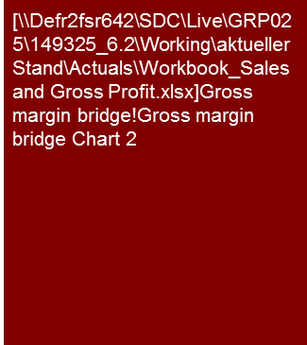
Sample analysis – Gross margin bridge
Sales & Gross Profit (historical)
The overall gross margin improvement by 0.8 percentage points cannot be reduced to few significant profit drivers.
Each of the five categories in the profit bridge can be broken down further, but based on our experience we would not expect breakthrough insights from more detailed analysis (e.g. for mix effects, the department store business model will allow only limited shifts of floor space from low to high margin segments)
Gross margin 1 bridge ABC FY2008 to FY2009 (like-for-like)
1
2
3
4
5
Note: Sales include inter company unless otherwise stated
Sources: VDD report; Monthly management accounts; Management information; KPMG analysis
1
Supply conditions improved as a result of the ongoing process of consolidating the supplier base and as compensation for reduced creditor days
Floor space reallocation largely reflects a switch from Multimedia to Fashion and insolvency
Reflects reductions of rebates granted to personnel and stronger central control of rebates granted by stores
Mark-downs reflect a combination of:
the decrease of overstocking in respect of store xxx
additional write-downs to clear overstocking of (mainly Fashion and Sports merchandise) caused by a lack of coordination of the purchasing strategy
clearance of old inventory
Insolvency effects largely reflect the increased proportion of older marked down products within the overall sales mix
2
3
4
5

Slide 19
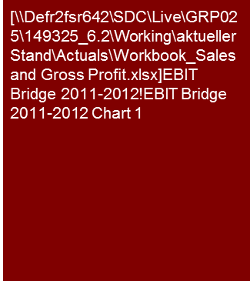
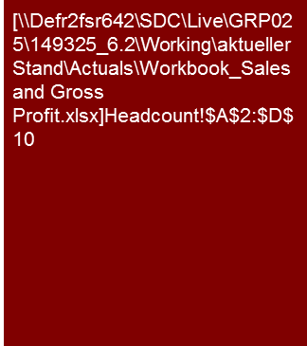
Sample analysis – EBIT bridge
Sales & Gross Profit (historical)
The decline in adjusted EBIT in 2012 is largely driven by:
A decline in sales volume;
partly offset by:
Positive impact from selling price changes and mix;
Headcount reduction; and
Savings from the relocation of a plant to low cost country.
Bridge – EBIT adjusted standalone 2011 – 2012
Delta - €6.7 Mio.
Sales
-€13.4 Mio.
Material costs
+€1.4 Mio.
Personnel costs
+€2.1 Mio.
(4.0)
1
2
3
4
5
6
7
8
Source: Management information
# | Description
1 | EBIT effect based on the decrease of sales volume of €36 million in 2012 at a 2011 variable cost of 45.3%.
2 | EBIT effect from overall selling price changes of third party sales and favourable mix effect from less “low-margin customer” projects.
3 | Savings resulting from supplier negotiations / supplier optimization.
4 | Savings resulting from redesigning existing products and improving production lines and packaging.
5 | Negative EBIT effect resulting from overall salary increase at 3.5%.
7 | Savings from shifting the manufacturing to low cost countries (in particular related to lower average salary levels).
8 | Other cost savings mainly related to overall fixed cost reduction (€2.0 million) and indirect cost saving due to plant relocation to low cost country (€0.5 million).
# | Description
6 | Cost savings due to headcount reduction (for variable production workforce: over proportionate reduction, i.e. higher than sales decrease).
Note: A bridge graph as presented above can generally only be generated in cooperation with target controlling

Slide 20
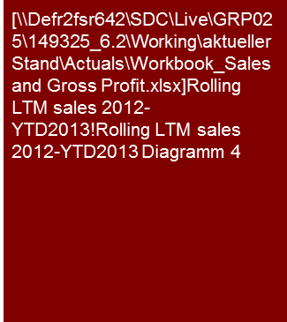
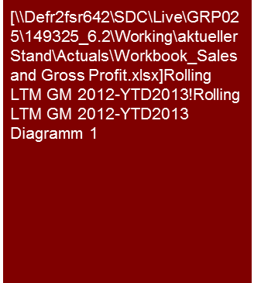
Sample analysis – Sales and margin trend analysis
Sales & Gross Profit (historical)
From a rolling last twelve months (LTM) perspective, sales and gross margin are behind the 2013 forecast.
Achieving 2013 forecast EBITDA margin appears particularly challenging given the recent rolling LTM trend.
Trend analysis - Rolling LTM sales, 2012 - YTD13
Note: A trend analysis should illustrate the business’s historical growth (or decline) and whether and to what extent such trend can be expected to continue.
An LTM (last 12 months) presentation can be helpful to show sales trends when month on month growth is impacted by seasonality, but the downside is that changes in trends (e.g. decline in sales after a period of growth or sales decline coming to a halt) will be less visible compared to a month on month analysis.
FY13 full year forecast amount
Trend analysis - Rolling LTM gross margin, 2012 - YTD13
Note: Sales include inter company unless otherwise stated
Sources: VDD report; Monthly management accounts; Management information; KPMG analysis

Slide 21
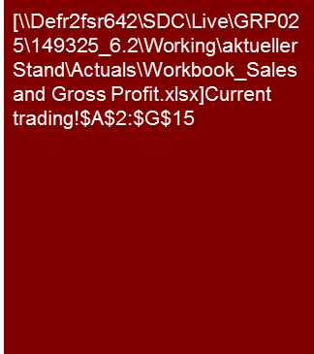
Sample analysis – Current trading (cost of sales method)
Sales & Gross Profit (historical)
At a group level, company YTD13 trading results are in line with budget although below the comparable prior year period due to higher SG&A expenses.
Order intake and order backlog are however significantly behind forecast which may have implications for the achievability of the full year forecast.
The YTD sales shortfall in the two largest sales countries, Norway (-15.5%) and Finland & Russia (-12.3%) was offset by a significant surplus in the USA due to projects being carried out earlier than expected in the budget.
Current trading overview
YTD13 gross profit of €17.2 million and EBITDA of €3.9 million are broadly in line with the YTD13 forecast. This result is a mixed effect of lower sales in Norway, Finland & Russia due to project postponements offset by early project deliveries in USA.
Gross profit margin is slightly behind budget (-0.3pp) primarily due to subcontracting costs paid for a postponed project in Norway.
The EBITDA margin of 8.0% is in line with budget but behind the prior year level of 9.4%. This is due to €0.9 million higher SG&A costs for sales personnel used for the ramp-up of the After Sales business.
FY2013 Forecast
Management commented that the FY2013 forecast of €162.1 million and EBITDA of €17.2 million is now more challenging based on the lower than planned order intake in YTD April but it still considers this to be achievable. We note that the FY2013 forecast was already adjusted downwards by €2.1 million based on Q1 trading results, to reflect the lower sales in Norway and recent project losses in Benelux.
Visibility on the outturn from the order backlog is unfortunately low due to the nature of company’s business which often involves deliveries on short notice (in particular in the Products & Prefabrication business).
Key will be the development in company’s main market Norway which is covered in a separate section of this report.
Source: DRI 1.14.4.2.67, 1.14.4.2.67, 1.18.2.3, Deloitte VDD, KPMG analysis

Slide 22
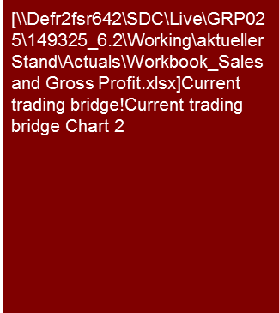
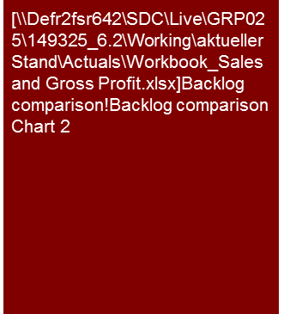
Sample analysis – Current trading
Sales & Gross Profit (historical)
Given that YTD13 sales are behind budget and prior year, combined with the order backlog also behind YTD in previous years, there is a risk that the 2013 forecast will not be achieved.
Management commented that some customers such as ABC are ahead of prior year and budget, while others such as DEF are ahead of prior year but behind budget.
Sales bridge, YTD April 2013 to 2013 forecast
Backlog comparison, YTD April
Primarily driven by XYZ (cranes) and UVW (general business).
General products/ business usually on short notice.
Note: Sales include inter company unless otherwise stated; YTD = year to date April; 13B = Budget FY2013
Sources: VDD report; Monthly management accounts; Management information; KPMG analysis

Slide 23
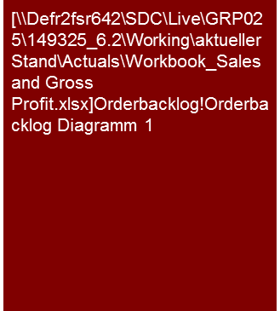
Sample analysis – Order intake and order backlog
Sales & Gross Profit (historical)
Order intake in 2011 amounted to €67.2 million compared to €55.9 million in 2010 representing an increase of 20% (despite the big Syria and Algeria orders in Q4 2010).
The order backlog at 31 December 2011 was higher than the previous year (excluding the large Syria and Algeria orders received in 4Q 2010).
According to management, order intake in 2011 is based on a wider customer basis with nearly all sales per individual customer being smaller than €1.0 million.
Development of order intake backlog 2009 to 2011
Order intake 2009: €47.3m
Order intake 2010: €55.9m
Order intake 2011: €67.2m
Source: Management information
Note: If order intake is lower than sales (book to bill ratio <100%) sales should be expected to decline.

Slide 24
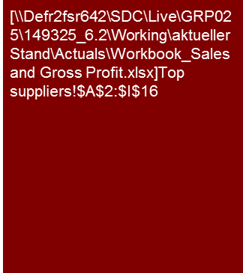
Sample analysis – Top suppliers
Sales & Gross Profit (historical)
Note: Include as appropriate contract duration, minimum (take or pay) volumes to be purchased, price adjustment mechanisms (e.g. diesel floater for shipping costs) or other key supply contract terms
The top 20 suppliers accounted for approximately 66% of total purchases in 2011 slightly higher than 2009 and 2010.
The majority of suppliers have an individual share of less than 5% and Management has not identified any significant supplier dependencies.
In 2011, the company bundled certain orders to achieve favorable pricing and has also entered into contract manufacturing arrangements for specific production steps.
Standard payment terms are in place with the majority of suppliers which specify payment on the 25th of the month following the invoice date typically with a 2 or 3% discount if paid on time.
The company also receives volume based rebates of 2% on annual purchases from suppliers “F”, “G”, “H” and “I”.
“A” and “B”, related parties of the company are the two main suppliers of OEM products. The company sources four different products from “A”. The increase in 2011 was mainly due to high sales of OWTS systems produced by “A”.

Slide 25
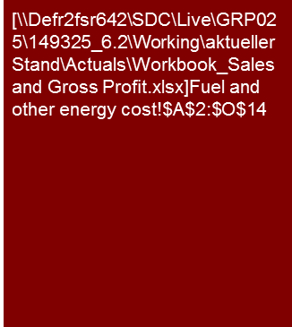
Sample analysis – COGS deep dive
Sales & Gross Profit (historical)
On a constant currency basis, fuel costs increased by €6.7 million from 2010 to 2012. We estimate that this was a combination of higher fuel prices (€9.4 million) offset by fuel efficiency programs (€1.0 million) and volume impacts due to the reduction of kilometers.
Note: FY10 fuel and other energy cost at FY11 FX rate.
Source: Vendor due diligence; KPMG Analysis
We present above fuel and other energy costs by country on a constant currency basis using the FY11 exchange rates. The exchange rate impact amounts to €+0.4 million in 2010.
The increase in fuel and other energy cost was primarily driven by a rise in fuel prices (20% rise from FY2010 to FY2011 on average). According to the VDD, the extent to which the price rises could be passed on to the client bodies was mixed. In the management presentation, management commented that the negative effect in the Czech Republic and Slovakia from the fuel price increase between FY2009 to FY2011 amounted to €6.9 million. Of this amount, management stated that €4.5 million could be passed on to the client body. In Poland per the VDD, the company lost customers when it tried to raise its prices.
In order to partially offset the impact of the increasing fuel price, management implemented certain initiatives to decrease consumption and improve efficiency. We estimate the savings from the initiatives to have been approximately €1.0 million.

Slide 26
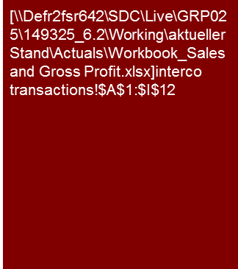
Sample analysis – Intra-group transactions and transfer pricing
Sales & Gross Profit (historical)
Intra-group transactions in FYxx amounted to €3.5 billion
Home Country (€1.6 billion) and APAC (€0.8 billion) have the highest deliveries to other regions
Deliveries into Home Country (€1 billion) include goods sold on to other regions
Deliveries from Home Country to APAC (€671 million) include chips from Plant A (front end) to Plant B (back end)
The general transfer pricing principles are:
market minus for finished goods; and
cost plus for components
Transfer pricing for deliveries to Home Country is cost plus and for deliveries from Home Country market minus (economic risk born by Home Country entities)
Intra-group transactions FYxx
General transfer pricing methods for Group
Cost plus: Target profitability for the manufacturing entity to be achieved (economic risk with entity selling to the market)
Market Minus Method ("MMM"): Target profitability for the entity selling to the market to be achieved (economic risk with manufacturing entity)
Transfer pricing applicable by types of transaction
Pre-manufactured components and raw materials:
Group generally applies cost plus
Finished goods - Transactions involving Home Country:
cost plus is applied for deliveries into Home Country (this includes goods sold on from Home Country to other Regions). Vice versa MMM is applied for all deliveries from Home Country .
As a result main Home Country entity assumes overall profit responsibility for transactions involving Home Country
"Cross sourcing" (transactions not involving Home Country)
Generally MMM is applied, i.e. the manufacturing entity bears the economic risk. Exceptions exist however for countries with special local transfer price rules
As an example, Brazilian authorities require that subsidiaries of foreign companies achieve a minimum gross profit (based on the total cost format, i.e. revenues less cost of materials) of 30%
Frequency of transfer price adjustments
Typically transfer prices are reviewed and adjusted half yearly in April (based on half year results) and in August (prior to financial year end)
Depending of how material the variances between budgeted and realized margins are, transfer prices may be adjusted more often and intercompany credits can be issued as if transfer prices were adjusted retrospectively
Eastern Europe In: 48.1m Out: 44.1m
0.0m
3.0m
NAFTA In: 96.2m Out: 23.1m
3.1m
2.1m
Western Europe In: 172.1m Out: 73.4m
11.4m
43.8m
34.0m
167.4m
59.7m
Home country In: 307.8m Out: 523.8m
70.8m
0.0m
2.9m
0.0m
0.0m
LATAM In: 38.5m Out: 0.1m
16.4m
22.9m
MEA In: 39.0m Out: 0.1m
0.0m
191.6m
213.6m
0.1m
17.5m
APAC In: 224.5m Out: 261.4m
0.0m
0.0m
15.3m
Note: Excluding transactions between regions not adjacent in the graph, e.g. APAC/NAFTA
Source: Mgmt. information, consolidation system
Note: Figures are based on COGS entries in consolidation system and may include consolidation entries (e.g. for inter-company profit elimination): yellow boxes mark transactions within regions
Source: Mgmt. information, consolidation system

Slide 27
© 2017 KPMG International Cooperative (“KPMG International”). KPMG International provides no client services and is a Swiss entity with which the independent member firms of the KPMG network are affiliated.

